Slide 1


Join at slido.com
#33856439
ⓘ
Click Present with Slido or install our Chrome extension to display joining instructions for participants while presenting.
Notes:
📣 This is Slido interaction slide, please don't delete it.
✅ Click on 'Present with Slido' and the joining instructions will appear when you get to this slide.

Slide 2
Exploratory Data Analysis (EDA) I
⚠️ Reminder to start the Zoom recording!
LECTURE 2
Fundamental tabular manipulations and visualizations
Data 100/Data 200, Fall 2026 @ UC Berkeley
Ramesh Sridharan and Jeremy Sanchez
Content credit: Acknowledgments

Slide 3
Announcements!
Discussion and Staff Office Hours start this week!
Discussion assignments have been released!
The deadline to switch discussion sections (or opt-out/in) is Friday 9/18
Prerequisite Quiz signups are live on PrairieTest! Check out #56 on Ed for logistics.
Instructor OH start today! Wheeler 210, 2-3PM (right after lecture, upstairs)
Ed policy: instructors have forbidden course staff from answering redundant questions
Homework 00 (coding and math portion) due this Friday (Sept. 4th) at 11:59PM
Fill out the Final Exam Conflict form ASAP if you have a final exam conflict or DSP-related overlap (Data 100 Final Exam: Wednesday, December 16th @ 11:30 - 2:30 PM)
DSP Students: Make sure your accommodation letters are submitted via the DSP portal
Notes:
Slightly formalized in wording, but still mostly the same:
Ask a Question
Obtain Data
Understand the Data
Understand the World

Slide 4
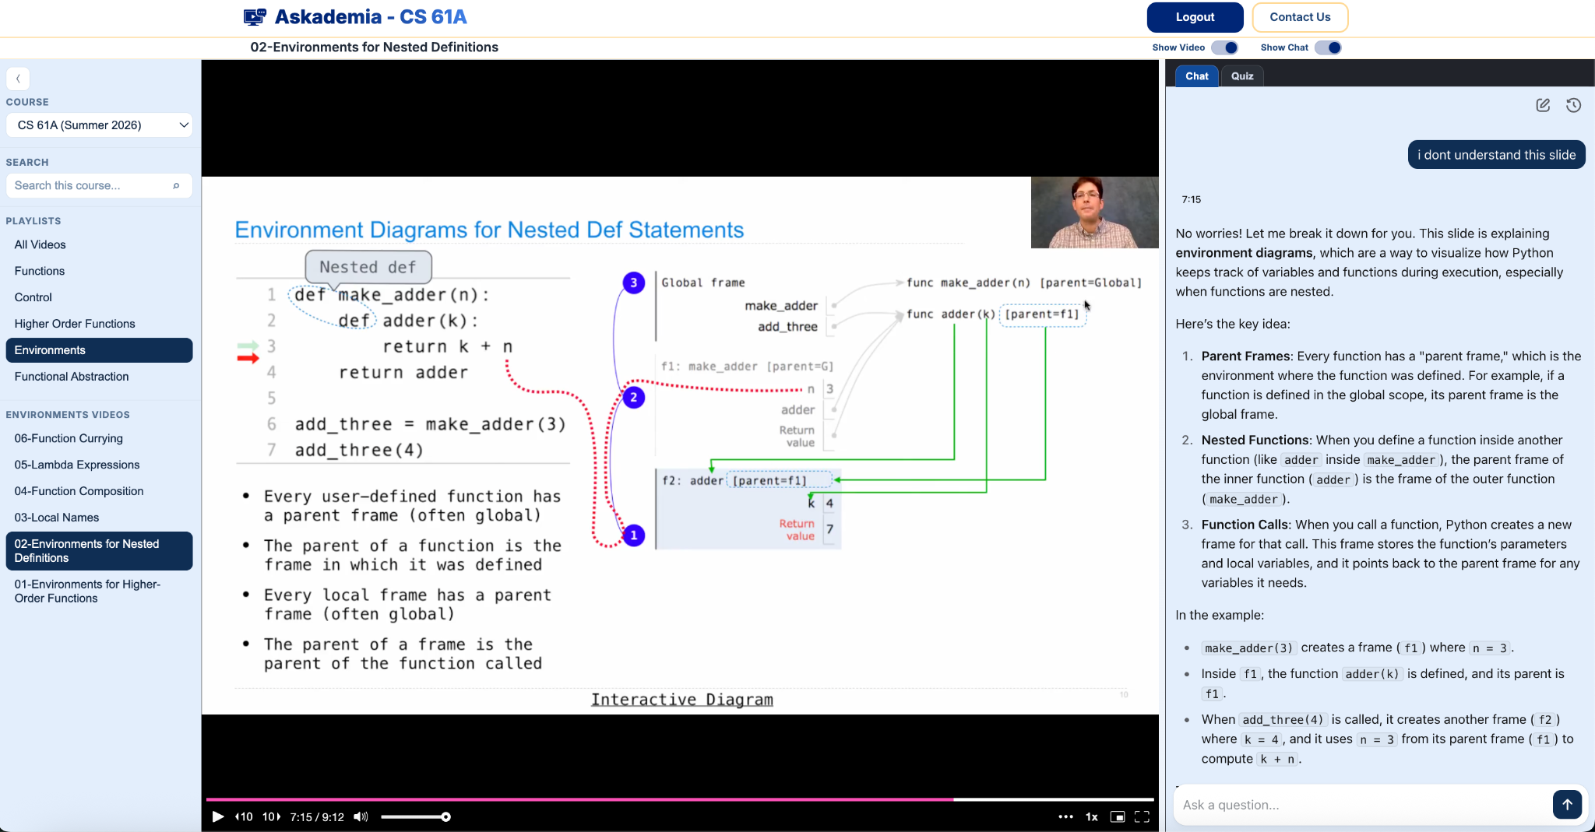
Temporarily down! We’ll make an announcement when it’s back up and running.
Askademia!
Developed by a former Data 100 TA
Also, no ads! (YouTube has ads)

Slide 5
Review: Tabular Data + Berkeley Admission Data
Today’s lecture starts from slide 15

Slide 6
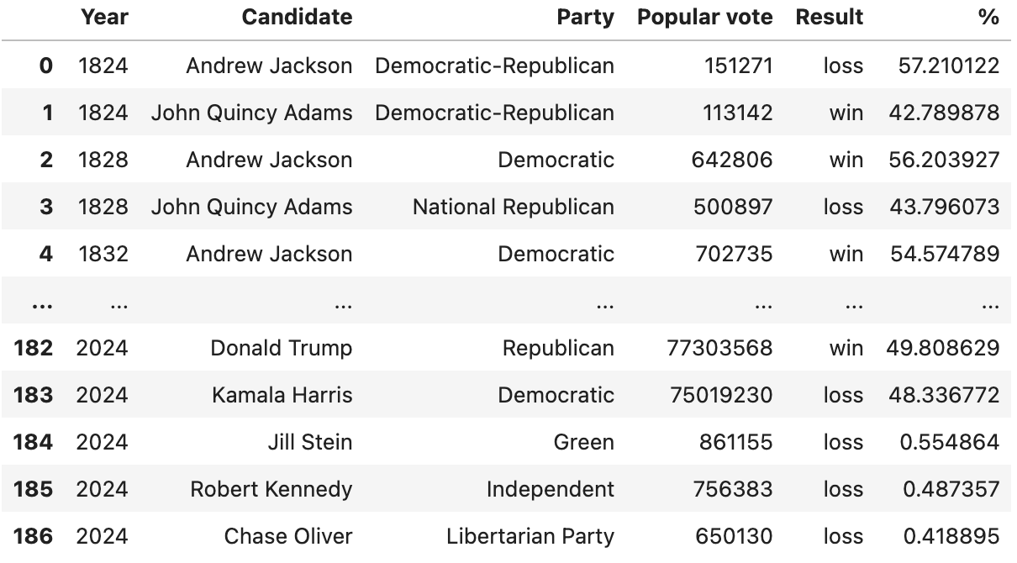
Data Scientists Love Tabular Data
Tabular data = data in a table.
Typically:
A row represents one observation (here, a single person running for president in a particular year).
A column represents some characteristic, or feature, of that observation (here, the political party of that person).
In Data 8, you worked with the datascience library using Tables.
In Data 100, we’ll use a new(ish) industry-standard library called polars (and SQL).

Slide 7

Our Python Data Science Tools: polars and SQL
polars is a Python (and R, …) library for working with tabular data in dataframes.
Successor to the industry standard pandas, which has similar syntax
Similar to the datascience library from Data 8
SQL is a declarative programming language for working with tabular data in databases.
Completely different syntax from Python
Most of our SQL will be a review from CS61A / 88C
SQL

Slide 8
Tabular manipulation
The framework of manipulating and visualizing tabular data is shared across languages.
The goal of Data 100 is not to "learn" polars (or SQL). Data 100 is not a coding class.
Data 100 provides mental frameworks that apply to any particular tool you use in the future.
In other words, we are establishing a shared language you can use to describe manipulations and visualizations of tabular data to other people (and LLMs!).

Slide 9
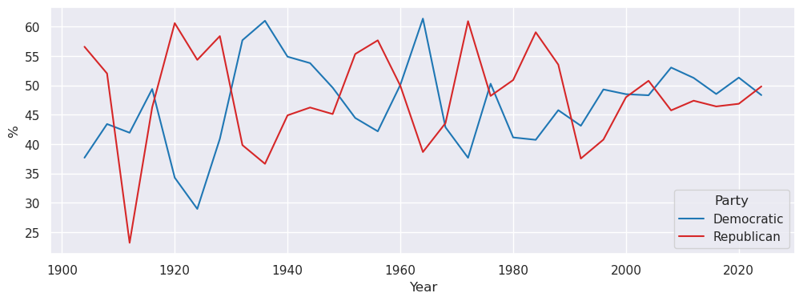
A typical exploratory data analysis (EDA) workflow
A few snapshotted tables (or just one!)
Database with many dynamic tables
Basic table manipulations with SQL
Visualize with seaborn
(or R, matplotlib, Excel…)
Manipulate with polars
(or R, pandas, Excel…)
Dynamic: Updated frequently (e.g., after a customer purchase)
Snapshot: Version at some specific moment in time.

Slide 10
One road to UC Berkeley
~1,700 public schools in California (i.e., state-funded, no tuition) offer 12th grade.
Many public high school seniors (i.e., 12th graders) apply directly to UC Berkeley.
UC Berkeley chooses whether to admit each student who applies.
Admitted students then choose whether to attend UC Berkeley (i.e., enroll/matriculate)
Three outcomes: (1) apply, (2) admit, and (3) attend
Students can also apply to UC Berkeley from private high schools in California, out-of-state high schools, international high schools, community colleges, and other colleges. We're going to focus just on public high schools in California.

Slide 11
Case Study: Analyst at Admissions Office
Scenario: You are an analyst working for the UC Berkeley admissions office.
Your manager asks you to identify five California public high schools that defy typical patterns of application, admission, and/or attendance.
The admissions office wants to visit these schools to figure out what's going really well or really wrong.

Slide 12
Clarifying the task
Task: Your manager asks you to identify five California public high schools that defy typical patterns of application, admission, and/or attendance.
Data analysis is not solving problem sets. Your future manager is not hiding the correct answer for you to discover. Huge mindset shift!
Data science is about asking good questions (and attempting to answer them).
Asking questions is a PRACTICED skill. It drives your daily work. It's tested in interviews, too 🙂
Let's practice! What kinds of clarifying questions will you ask your manager before tackling this task?

Slide 13
Possible clarifying questions
Task: Your manager asks you to identify five California public high schools that defy typical patterns of application, admission, and/or attendance.
Why five schools? Why not three or ten or some other number?
Why focus on California public schools? Why not a different state? Why not private schools?
What is a "typical" pattern? Is this defined across all schools or just similar groups of schools?
Do you care most about applications, admission, or attendance?
Do you want to look at schools over time, or just in one year?
Are you more interested in high-performing schools or low-performing schools?
What kind of data do we have access to? What data could we request access to?

Slide 14
Lecture 1 Ended Here!

Slide 15
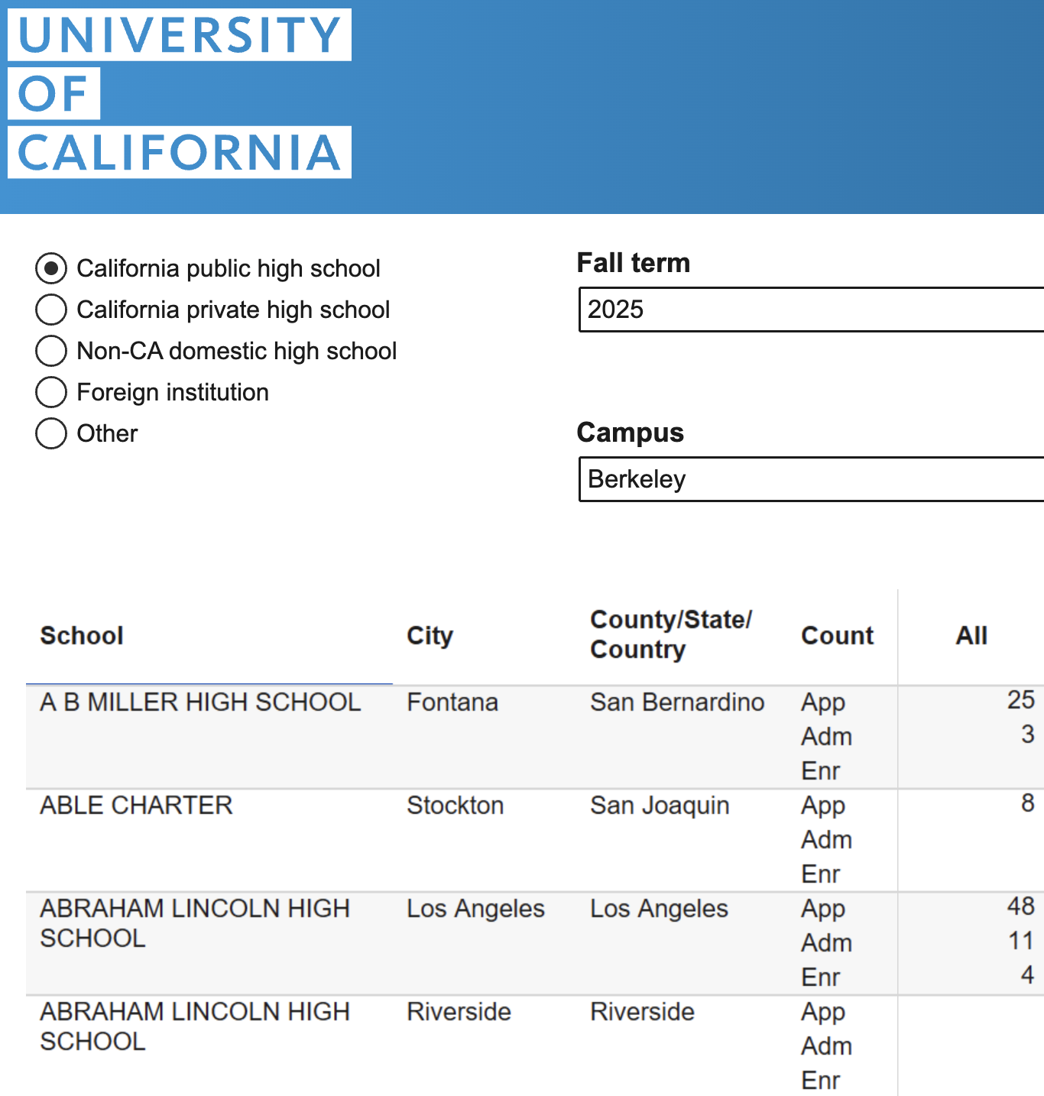
The admissions data
UC provides data on the number of applicants, admits, and attendees from schools around the world.
We will work with the public high school (HS) data for students admitted in 2025.
🧙There is lots of public data on the internet. Be scrappy! You are not helpless!
🧑‍💻 Personal project idea: Repeat analysis for multiple years, types of high schools, and different UC campuses.
Data: universityofcalifornia.edu/about-us/information-center/admissions-source-school

Slide 16
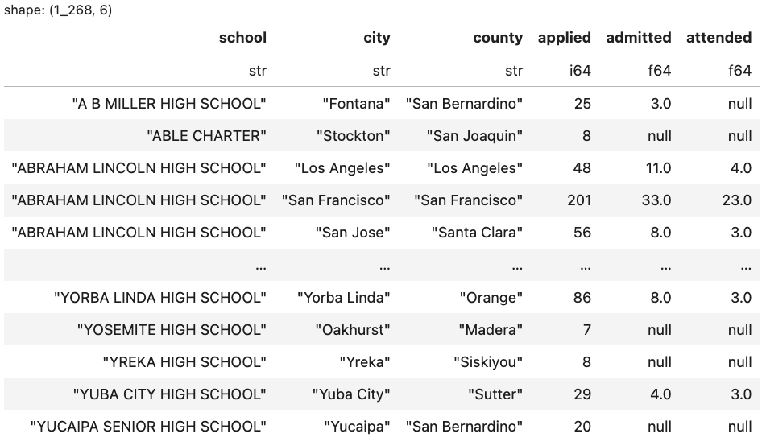
The admissions dataset
What questions do you have about this dataset? What do you know from just this preview?

Slide 17



Do not edit
How to change the design
What questions do you have about this dataset? What do you know from just this preview?
Presenting with animations, GIFs or speaker notes? Enable our Chrome extension
Notes:
📣 This is Slido interaction slide, please don't delete it.
✅ Click on 'Present with Slido' and the poll will launch automatically when you get to this slide.

Slide 18
The admissions dataset
What questions do you have about this dataset? What do you know from just this preview?
English | Polars Code | SQL Query
Load in the dataset. Show a preview of the data. | df = pl.read_csv('pivoted-ucb-admissions.csv') df | SELECT * FROM admissions
CSV: Comma separated values file. Common way to store tabular data.
df: DataFrame, the polars object for tabular data.

Slide 19
Code in Data 100
Data scientists are doing more of their work by giving LLMs specific instructions in English, as opposed to writing code from scratch.
That being said, data scientists often need to read and understand code produced by LLMs and by other data scientists.
Data 100 is adapting to this trend. You will spend more time providing precise English instructions and interpreting code, as opposed to writing code from scratch.
You can still complete Data 100 without ever interacting with an LLM! But, to stay competitive on the job market, we encourage you to develop basic fluency with LLMs.

Slide 20
Relevant questions about the admissions dataset
Task: Your manager asks you to identify five California public high schools that defy typical patterns of application, admission, and/or attendance.
Do you trust the data? How closely does it correspond to the truth? Context and inspection.
Which schools have the highest application/admission/attendance rates? Extremes.
How much do application/admission/attendance rates differ across schools? Distributions and variation.
Are other school characteristics related to the rates above? Correlation.
We could ask more, but let's start with these next time!

Slide 21
Relevant questions about the admissions dataset
Task: Your manager asks you to identify five California public high schools that defy typical patterns of application, admission, and/or attendance.
Do you trust the data? How closely does it correspond to the truth? Context and inspection.
Which schools have the highest application/admission/attendance rates? Extremes.
How much do application/admission/attendance rates differ across schools? Distributions and variation.
Are other school characteristics related to the rates above? Correlation.
We could ask more, but let's start with these for now!

Slide 22
Questions about data provenance (i.e., where the data comes from)
Our data
From website
👋
Where did our data come from?
UC admissions public data
We reshaped the data to make it easier to work with. The transformation above is called a pivot.
No values were changed in the pivot. Missing values are shown as null.
We dropped rows with no visible data.

Slide 23
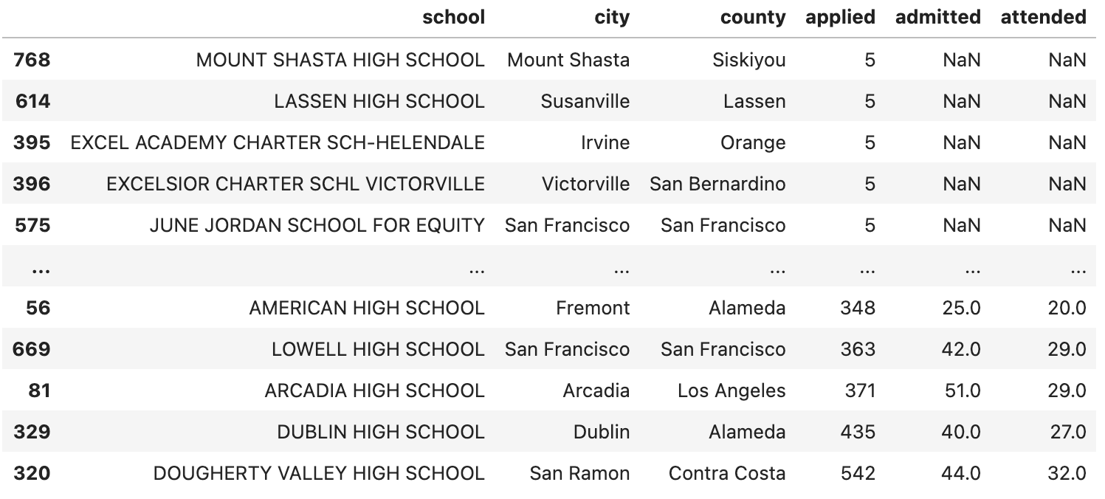
Why is there missing data?
Do you trust this data? Is it "complete"?
Admit/attend counts <3 are written as null (i.e., missing). See Documentation.
We excluded schools with <5 applicants.
Why does UC hide low counts? Privacy. Imagine a HS with applied=1 and admitted=0. Suppose you know a student from that HS who applied to Berkeley. With your knowledge and the UC data, you could figure out that student was rejected from Berkeley. Breach of privacy!
Seminal research about identifiability: Sweeney (2000)
In the news recently, too!
English | Polars Code | SQL Query
Sort the dataset in ascending order by the 'applied' column. | df.sort('applied', descending=False) | SELECT * FROM admissions ORDER BY applied ASC

Slide 24
Reminder: The admissions dataset

Slide 25
Are all students represented?
Do you trust this data? Is it "complete"?
~1700 traditional public schools offer 12th grade in CA, but only ~1300 rows in dataset. Why?
English | Polars Code | SQL Query
Count the number of rows in the dataset. | len(df) OR df.shape[0] | SELECT COUNT(*) FROM admissions
Two main reasons:
1. Schools with no applicants are excluded from UC data entirely. See Documentation.
2. We also dropped rows with no visible data (i.e., 1–4 applicants).
English | Polars Code | SQL Query
Find the minimum of the 'applied' column. | df['applied'].min() | SELECT MIN(applied) FROM admissions
Same approach for max, mean or avg, std, and lots of other summarizing functions.

Slide 26
Data science wisdom
🧙 Data ≠ truth. Data can be a good/OK/bad/incorrect approximation of reality.
Just because it's in a neatly organized table does not mean it's reliable!
Be skeptical about your data. Where does it come from? What's missing? How is it limited?
Example concerns about admissions dataset:
Not all public high schools in California are represented.
We have limited information about schools with few applicants to UC Berkeley.
🧙 However, don't give up because of data limitations. Data scientists often make do with imperfect data. Be forthcoming about limitations, but push forward!

Slide 27
Possible questions about the admissions dataset
Task: Your manager asks you to identify five California public high schools that defy typical patterns of application, admission, and/or attendance.
Do you trust the data? How closely does it correspond to the truth? Context and inspection.
Which schools have the highest application/admission/attendance rates? Extremes.
How much do application/admission/attendance rates differ across schools? Distributions and variation.
How are distance from UC Berkeley, average socioeconomic status, free/reduced lunch percentage, and charter status related to the rates above? Correlations.

Slide 28
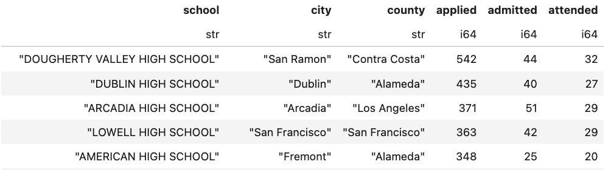
Identifying outlier schools
Which schools have the highest application rates?
Does this table answer the question?
No! These are counts, not rates.
⚠️Assumption!
Application rate = # applied / possible applicants
≈ # applied / # 12th graders
English | Polars Code | SQL Query
Sort the dataset in descending order by the 'applied' column. | df.sort('applied', descending=True) | SELECT * FROM admissions ORDER BY applied DESC

Slide 29
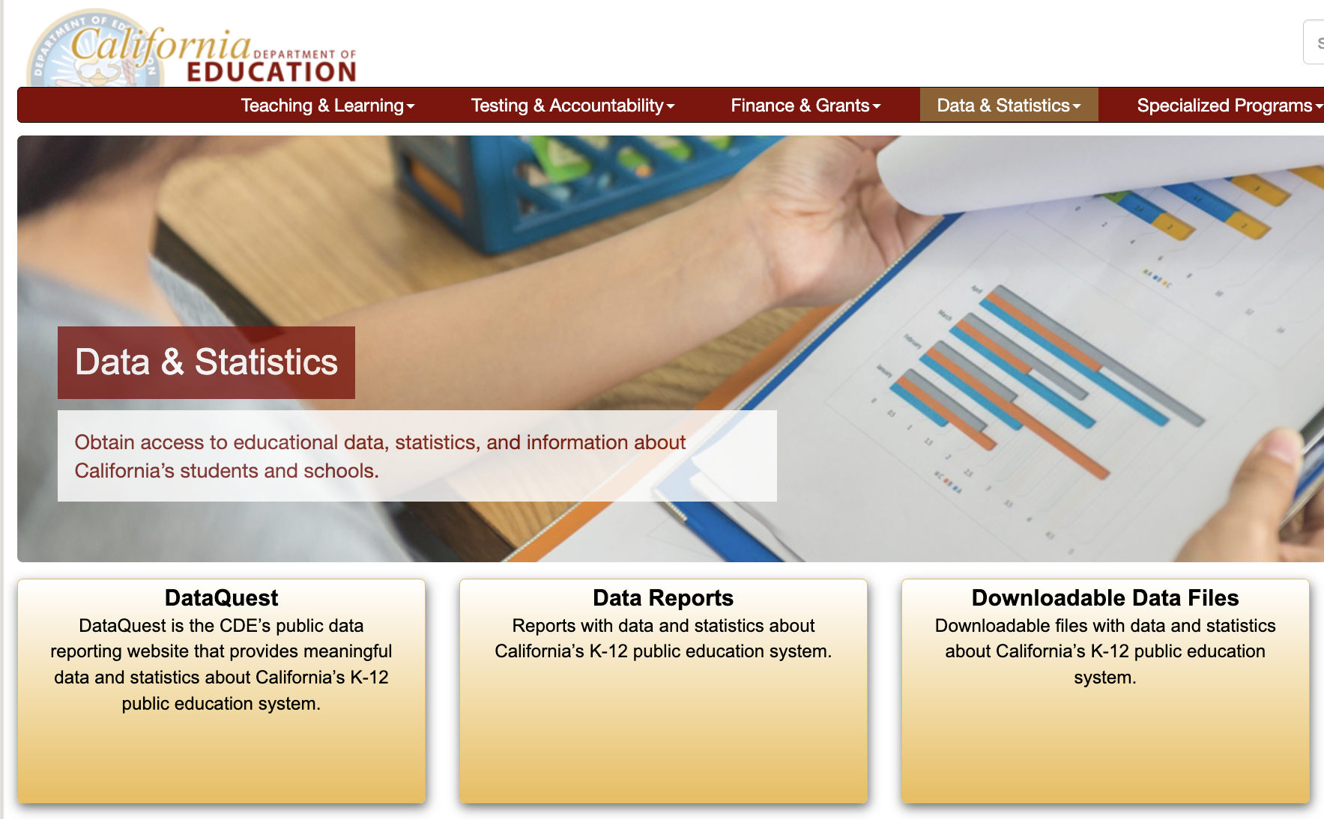

Slide 30
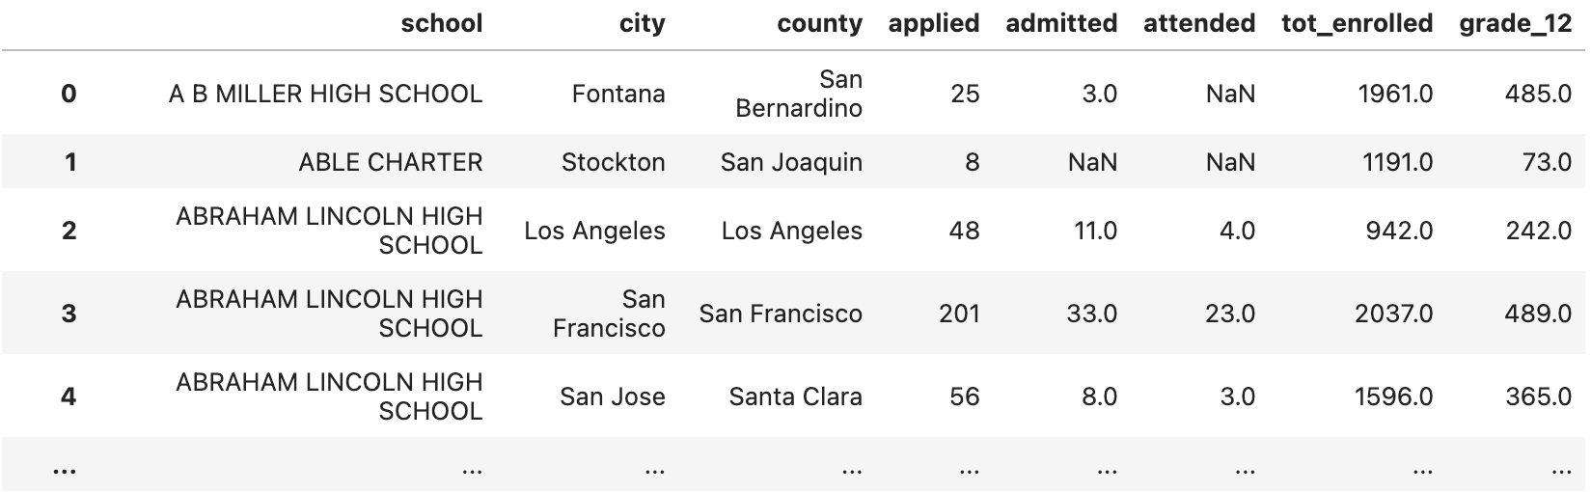
Joining in New Data
The California Department of Education publishes lots of data on schools in CA.
We can use the Census Day Enrollment Data to find the # of 12th graders at each school in the 2024-2025 academic year.
Then, we can join the UC admissions data to the 12th grade enrollment data. Note: Joining this data is tricky, since high school names can be written differently in different places.

Slide 31
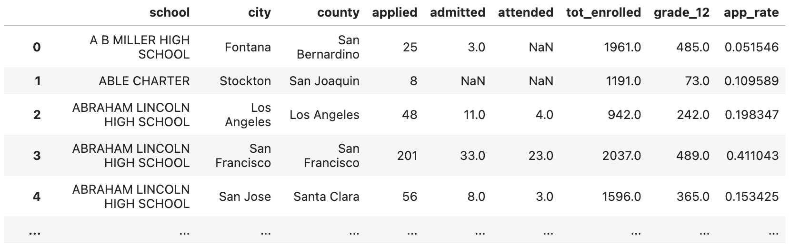
Computing the application rate
Application rate = # applied / # 12th graders
English | Polars Code | SQL Query
Create a new column with the application rate for each school. | df = pd.read_csv('pivoted-ucb-data-w-enrollment.csv') df = df.with_columns( app_rate=pl.col('applied') / pl.col('grade_12') ) | SELECT applied / grade_12 AS app_rate FROM admissions

Slide 32
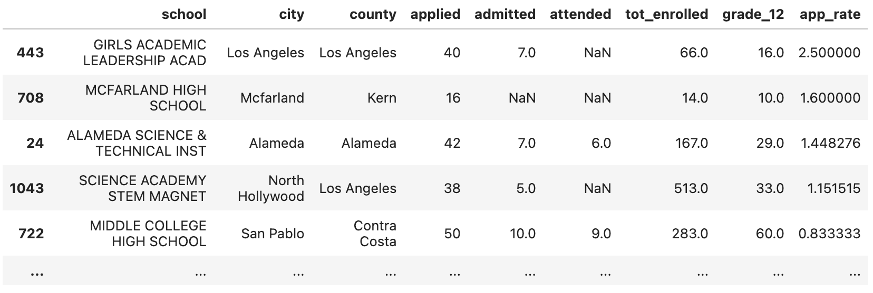
Highest application rates
Which schools have the highest application rates?
How can you have an application rate over 100%?
Data entry error? Maybe some 11th graders applied? Incorrect join?
English | Polars Code | SQL Query
Sort the DataFrame by the app_rate column in descending order. | df.sort('app_rate', descending=True) | SELECT applied / grade_12 AS app_rate FROM admissions ORDER BY app_rate DESC

Slide 33
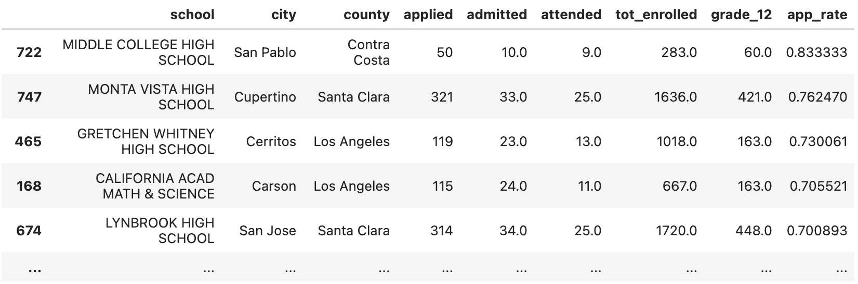
Highest application rates
The issue is rare. Let's filter the dataset to remove the four unusual data points.
Are we done? Do we have an answer to our manager's original question?
English | Polars Code | SQL Query
Filter data to rows where app_rate <= 1. Then, sort by app_rate. | df_new = df.filter(pl.col('app_rate') <= 1) df_new.sort('app_rate', descending=True) | SELECT applied/grade_12 AS app_rate FROM admissions WHERE app_rate <= 1 ORDER BY app_rate DESC

Slide 34
Do not edit
How to change the design
Are we done? Do we have an answer to our manager's original request to identify five unusual schools?
Presenting with animations, GIFs or speaker notes? Enable our Chrome extension
Notes:
📣 This is Slido interaction slide, please don't delete it.
✅ Click on 'Present with Slido' and the poll will launch automatically when you get to this slide.

Slide 35
Returning to the original question
We certainly have an answer, but is it the best we can do?
We have not considered low application rates, or admission/attendance.
We have not defined "typical pattern".
One of the schools is quite small. Another one looks like a specialized school.
Is this a good representation of different kinds of public schools in California?
🧙 One of the key tasks of a data scientist is to define "success". You'll often need to transform fuzzy instructions into concrete goals or metrics.
Task: Your manager asks you to identify five California public high schools that defy typical patterns of application, admission, and/or attendance.

Slide 36
Fundamental Operations So Far
View a preview of a dataframe.
Select specific rows or columns.
Create new columns.
Filter to specific rows.
Order the data by the values in a column.
Join in additional data.
More incoming!

Slide 37
Possible questions about the admissions dataset
Do you trust the data? How closely does it correspond to the truth? Context and inspection.
Which schools have the highest application/admission/attendance rates? Extremes.
How much do application/admission/attendance rates differ across schools? Distributions and variation.
How are distance from UC Berkeley, average socioeconomic status, free/reduced lunch percentage, and charter status related to the rates above? Correlation.

Slide 38
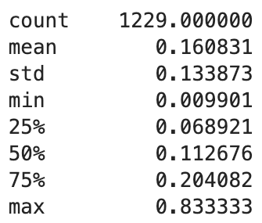
Summary statistics are OK!
What is the variation in application rates across schools?
Is this helpful?
Kind of. But humans process images a lot faster than text.
English | Polars Code | SQL Query
Compute summary statistics about app_rate. | df.select('app_rate').describe() | No concise equivalent

Slide 39
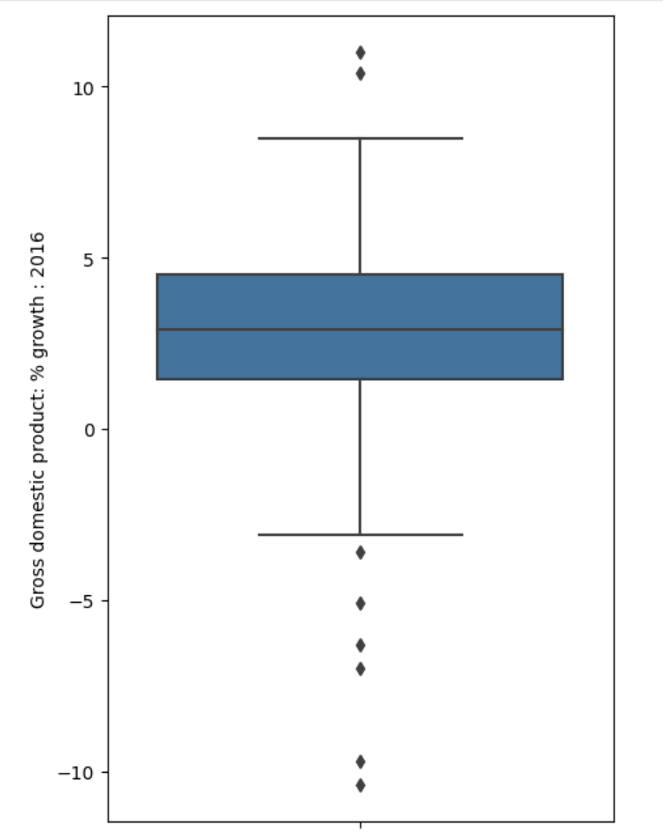
Box Plots
Outliers (> Q3 + 1.5*IQR)
Whisker: Largest non-outlier data point
3rd quartile (Q3, 75th percentile)
50% of the
data lives here
2nd quartile (median)
1st quartile (Q1, 25th percentile)
Whisker: Smallest non-outlier data point
Outliers (< Q1 - 1.5*IQR)
IQR = interquartile range = Q3 - Q1
Why 1.5? "I was present when Dr. John Tukey gave a talk, and he was asked... why 1.5 was chosen [for the IQR multiplier].... what he [Tukey] said was [that] 2 was too big... and 1 was too small... and 1.5 was just right."

Slide 40
Do not edit
How to change the design
What's the minimum possible length of a boxplot whisker? (Hint: try to come up with an example dataset and/or boxplot that would make the whiskers as small as possible)
Presenting with animations, GIFs or speaker notes? Enable our Chrome extension
Notes:
📣 This is Slido interaction slide, please don't delete it.
✅ Click on 'Present with Slido' and the poll will launch automatically when you get to this slide.

Slide 41
Hypothetical boxplot
Outliers (> Q3 + 1.5*IQR)
No Upper Whisker! All values above Q3 are outliers.
Q3
Q1
No Lower Whisker! All values below Q1 are outliers.
Outliers (< Q1 - 1.5*IQR)

Slide 42
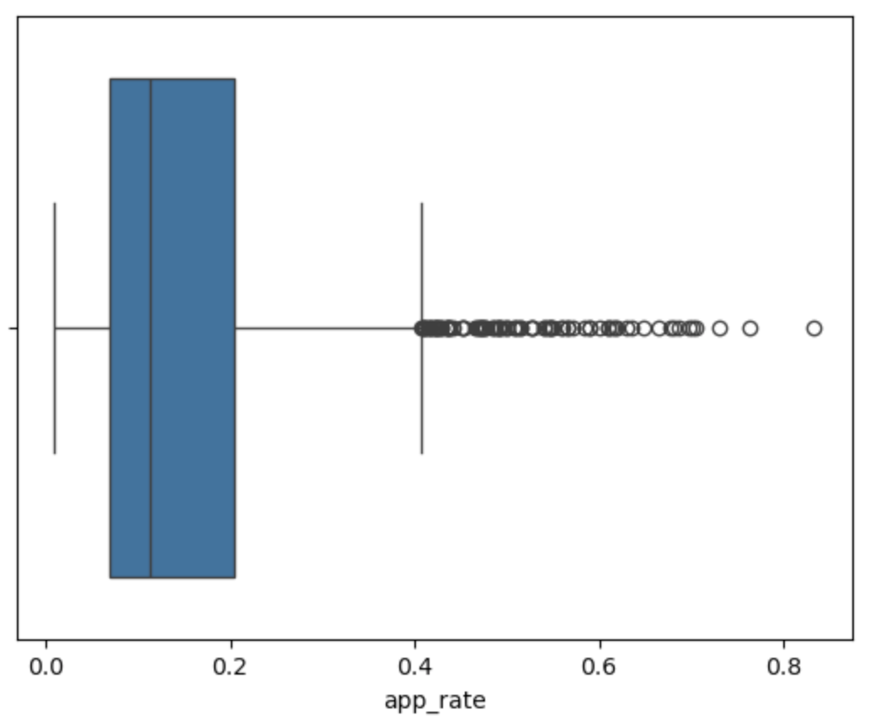
Box Plots
What is the variation in application rates across schools?
English | Seaborn Code
Make a boxplot of the values in app_rate. | sns.boxplot(df_new, x='app_rate')

Slide 43
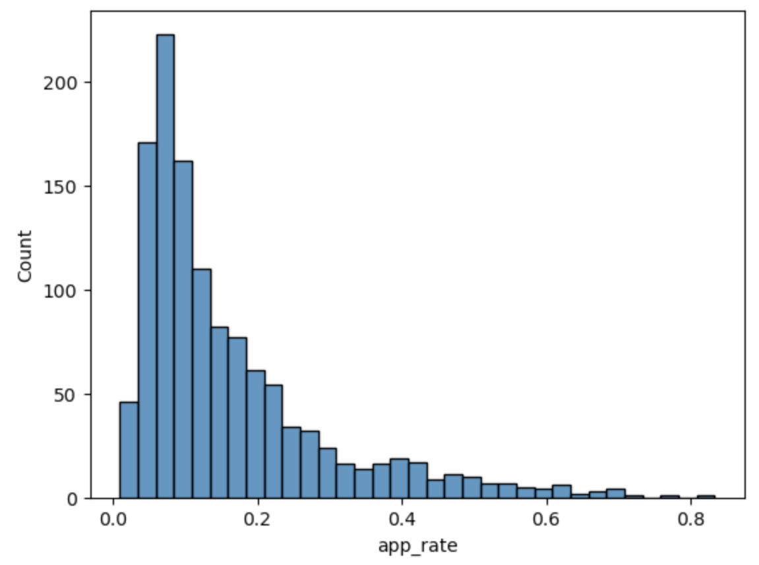
Histograms
What is the variation in application rates across schools?
English | Seaborn Code
Make a histogram of the values in app_rate. | sns.histplot(df_new, x='app_rate')

Slide 44
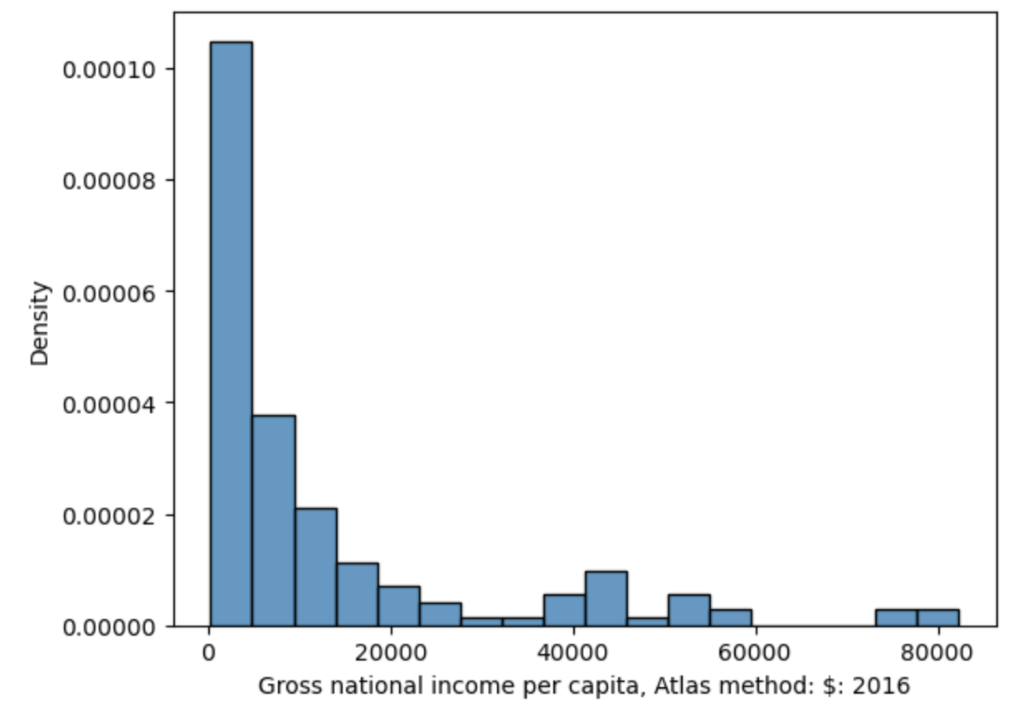
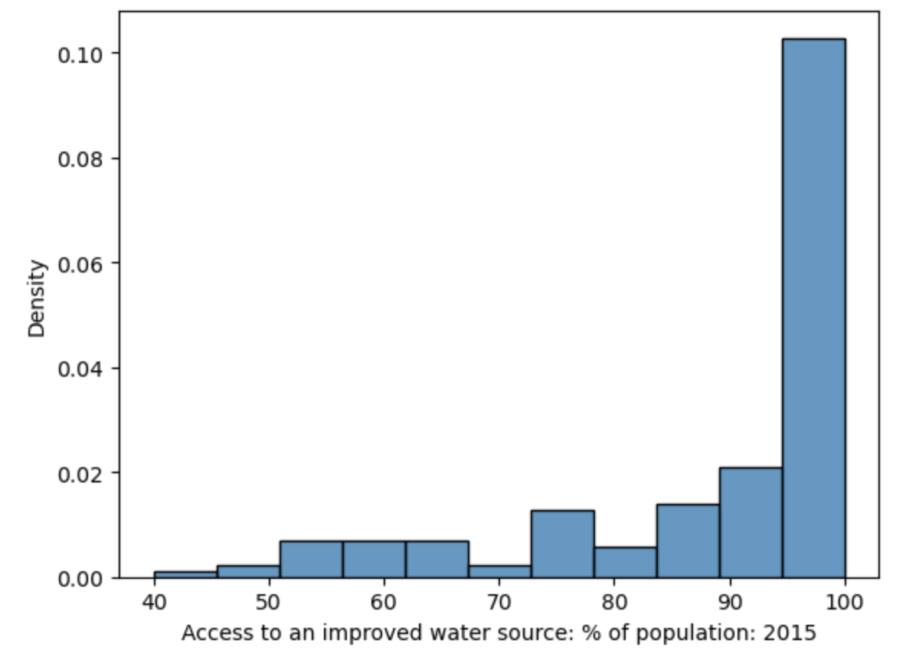
Interpreting Histograms
The skew of a histogram describes the direction in which its "tail" extends.
Right/positive skew → Mean > Median
Left/negative skew → Mean < Median
P
Looks like a P on its side → P for positive skew!
A long right tail
A long left tail

Slide 45
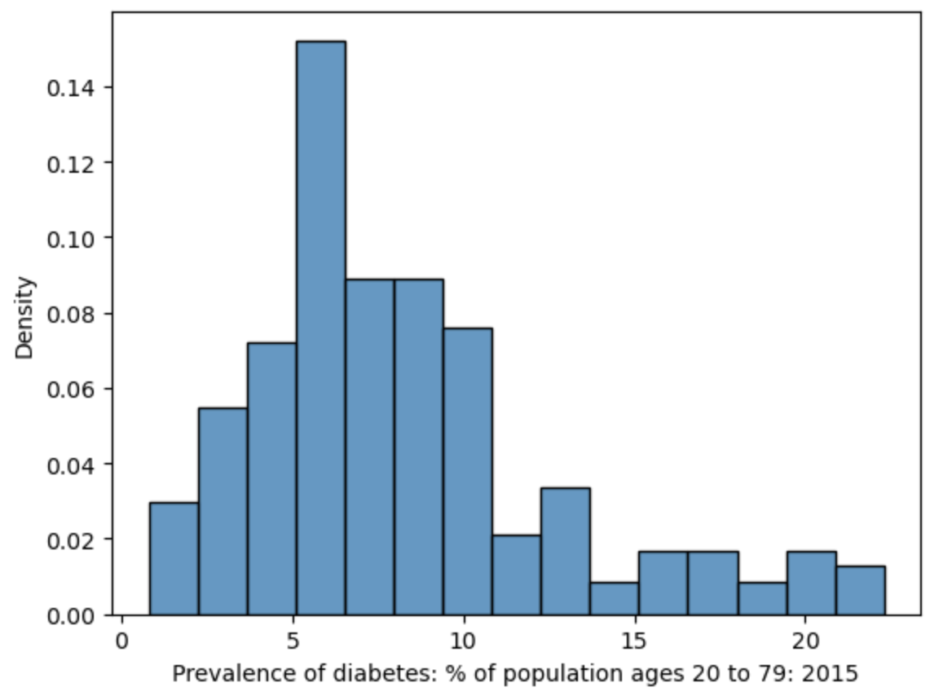
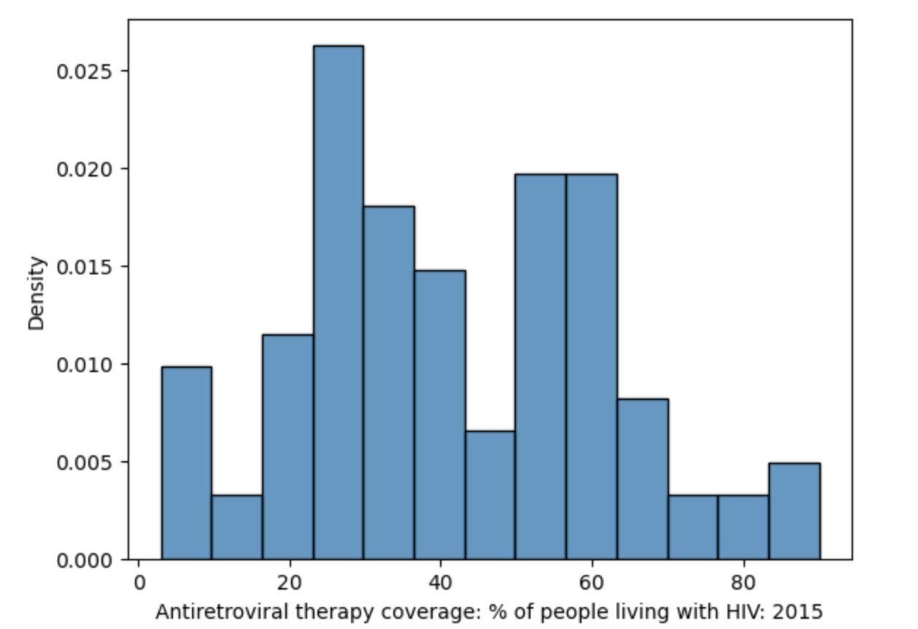
Interpreting Histograms
The mode is the most frequent value of a distribution.
A distribution with one clear peak is called unimodal.
Two peaks: bimodal.
More peaks: multimodal.
Bimodal?
Unimodal

Slide 46
Why does this pattern exist?
Why is there so much variation in application rates across schools?

Slide 47
Do not edit
How to change the design
Why is there so much variation in application rates across schools?
Presenting with animations, GIFs or speaker notes? Enable our Chrome extension
Notes:
📣 This is Slido interaction slide, please don't delete it.
✅ Click on 'Present with Slido' and the poll will launch automatically when you get to this slide.

Slide 48
Why does this pattern exist?
Why is there so much variation in application rates across schools?
Lots of reasons. The decision to apply is complex.
Money, distance, academic resources, individual and family priorities … do we have this data?

Slide 50
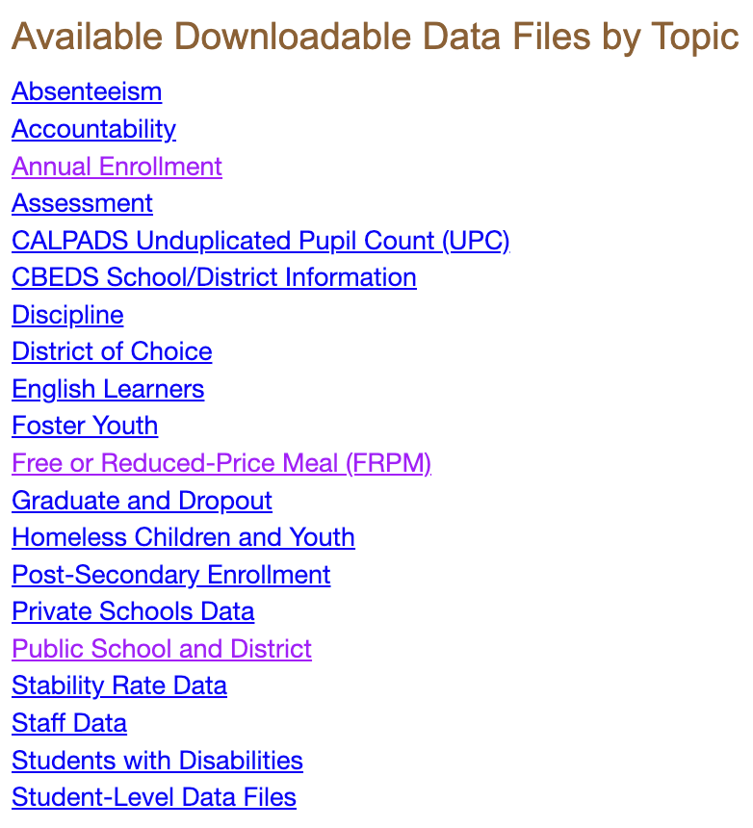
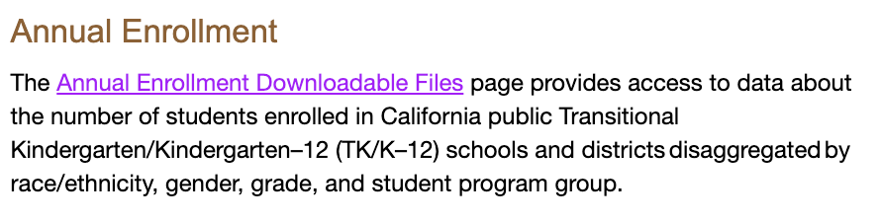
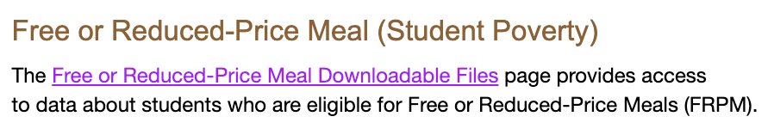
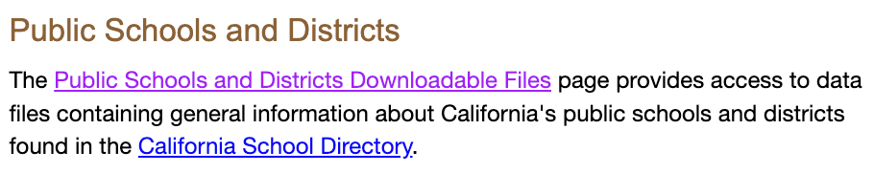
This is where we got the 12th grade count!
Proxy for average socioeconomic status.
Latitude/longitude of each school → Calculate distance to Berkeley?
Identify charter schools (i.e., more flexible/specialized)

Slide 51
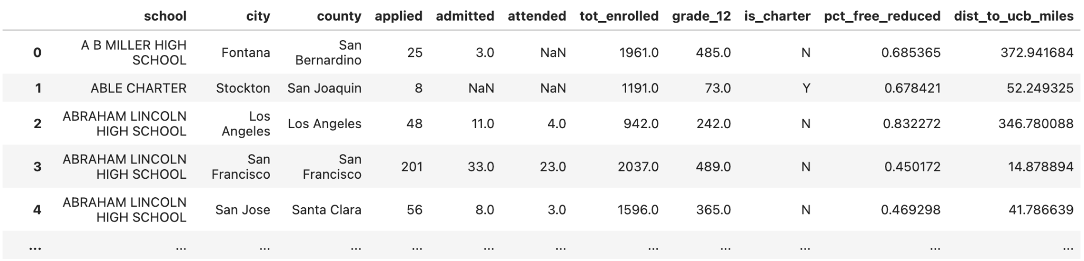
Joining in More New Data
Join the UC admissions data to the expanded California public schools data.
🧑‍💻 Personal project idea: Reproduce these joins from scratch. Download the raw data and talk to an LLM!

Slide 52
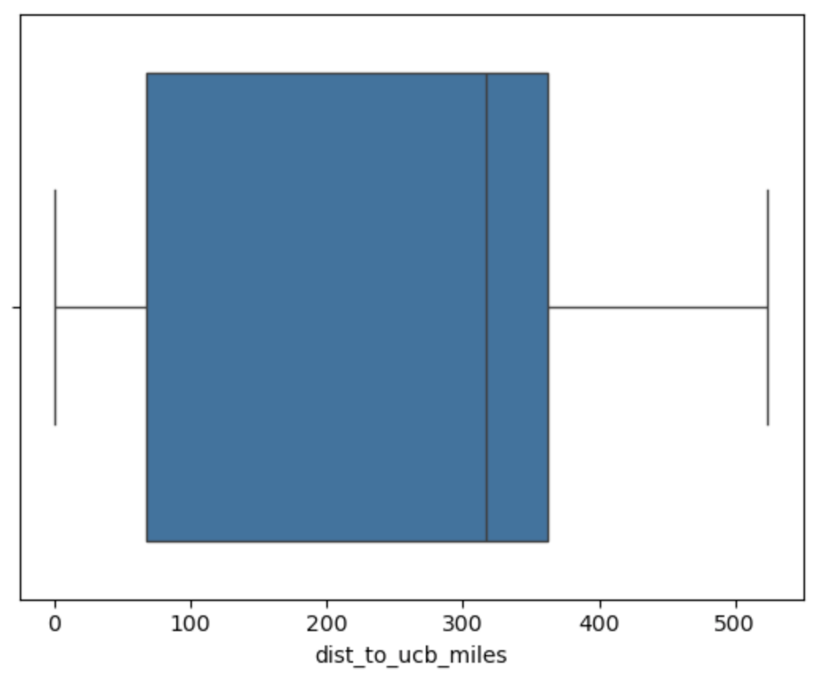
Distribution of Distances to UC Berkeley from each school
What is the variation in distance to UC Berkeley across schools?
English | Seaborn Code
Make a boxplot of the values in dist_to_ucb. | sns.boxplot(df_new, x='dist_to_ucb')

Slide 53
Distribution of Distances to UC Berkeley from each school
What is the variation in distance to UC Berkeley across schools?
English | Seaborn Code
Make a boxplot of the values in dist_to_ucb. | sns.boxplot(df_new, x='dist_to_ucb')

Slide 54
Do not edit
How to change the design
Here is the boxplot of dist_to_ucb_miles. Describe the shape of the histogram of dist_to_ucb_miles.
Presenting with animations, GIFs or speaker notes? Enable our Chrome extension
Notes:
📣 This is Slido interaction slide, please don't delete it.
✅ Click on 'Present with Slido' and the poll will launch automatically when you get to this slide.

Slide 55

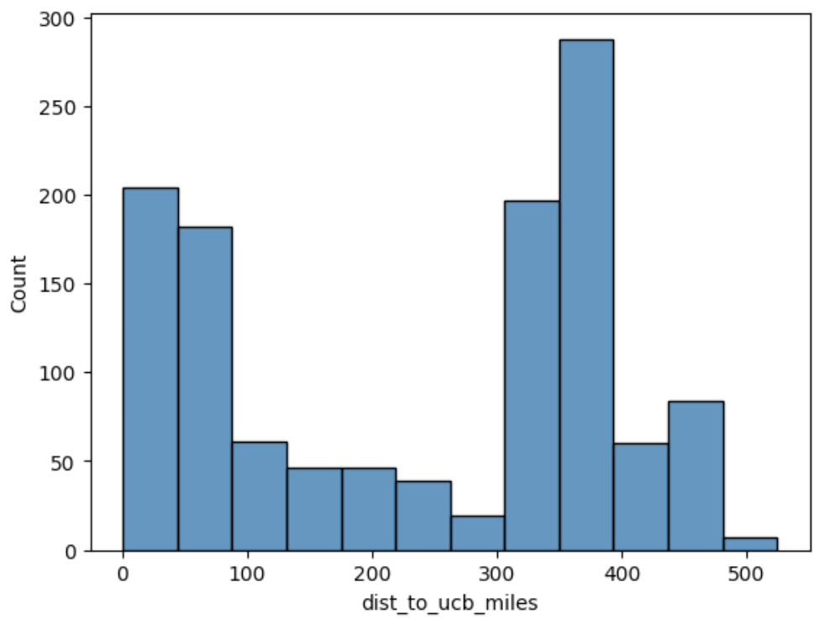
Boxplots and histograms are not interchangeable
Boxplots cannot show modality (i.e., number of peaks). But they are easier to glance at.
English | Seaborn Code
Make a histogram of the values in dist_to_ucb. | sns.histplot(df, x='dist_to_ucb')

Slide 56
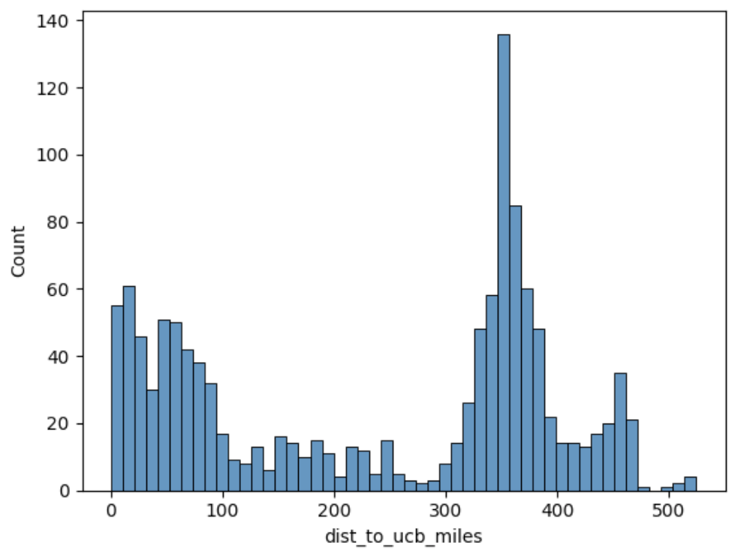
More bins → More detail
Add more bins to see more detail.
English | Seaborn Code
Make a histogram of the values in dist_to_ucb, using 50 bins. | sns.histplot(df, x='dist_to_ucb', bins=50)

Slide 57
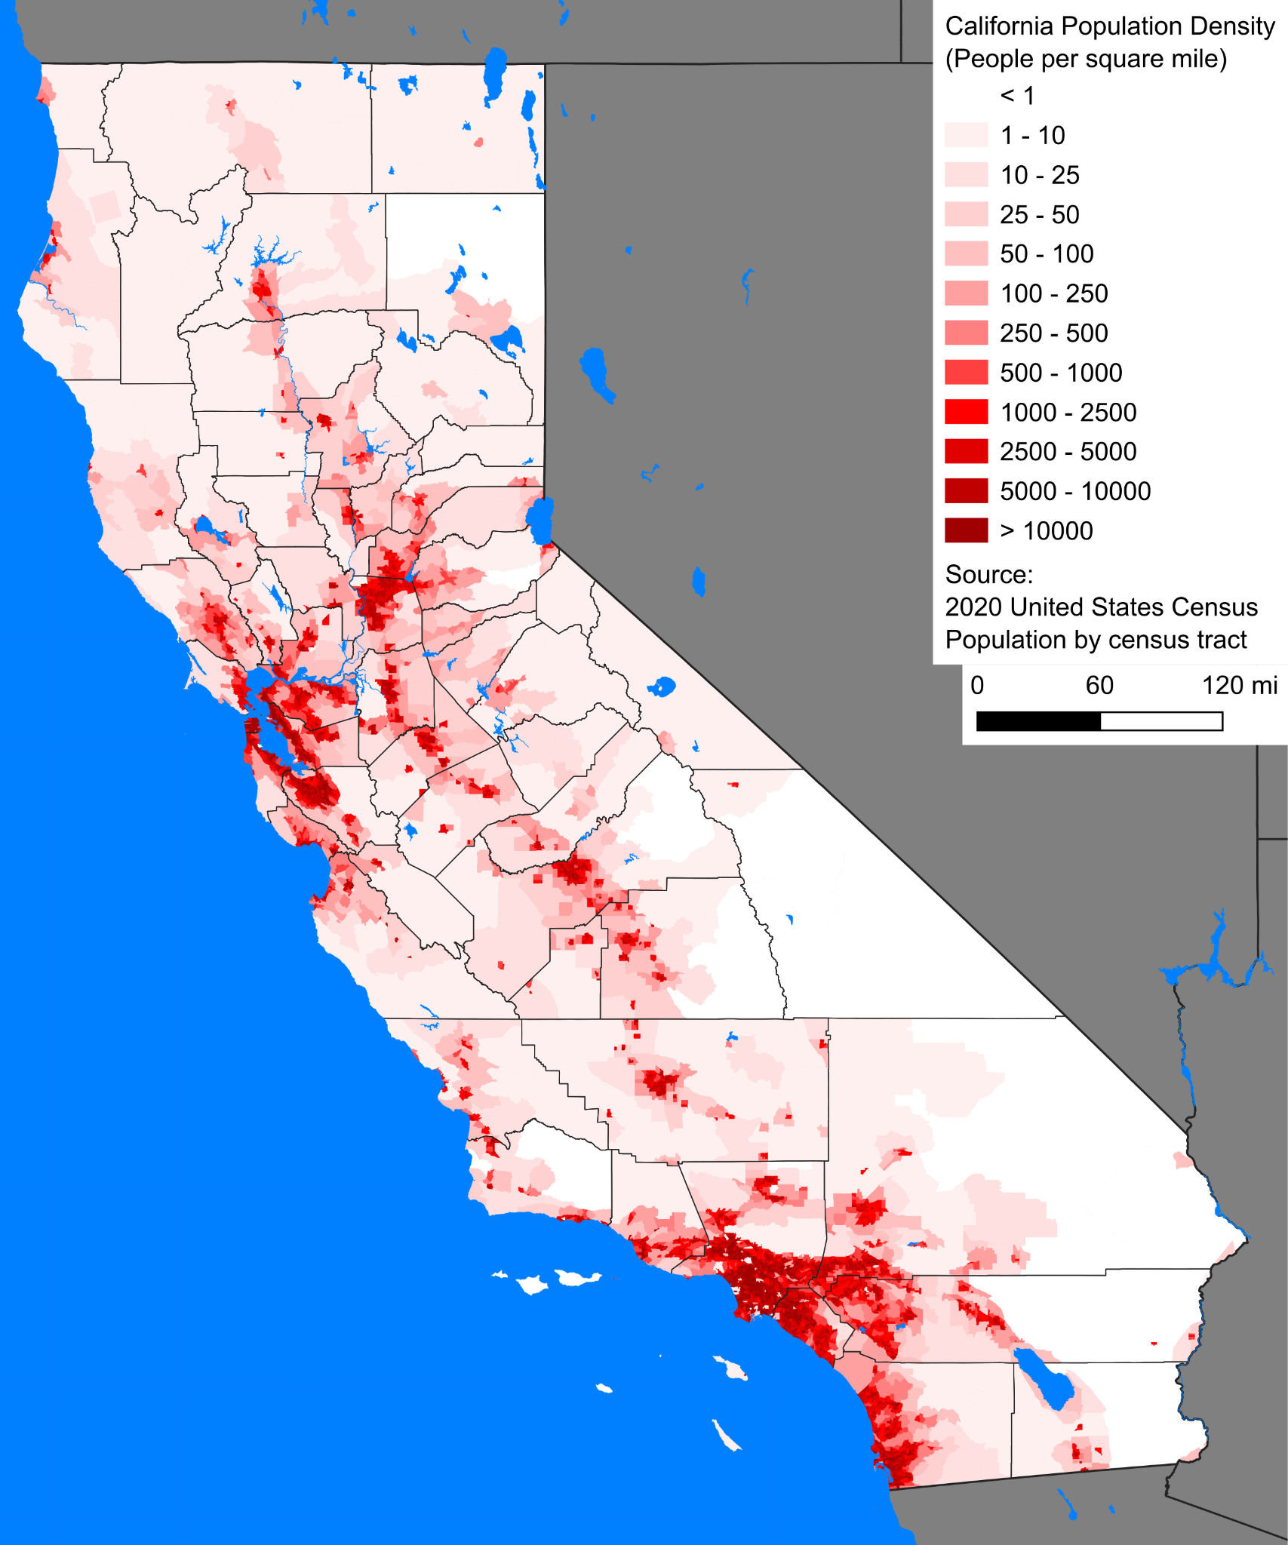

Connecting plots to real-world phenomena
Why are there three peaks (i.e., three modes, or trimodal)?

Slide 58
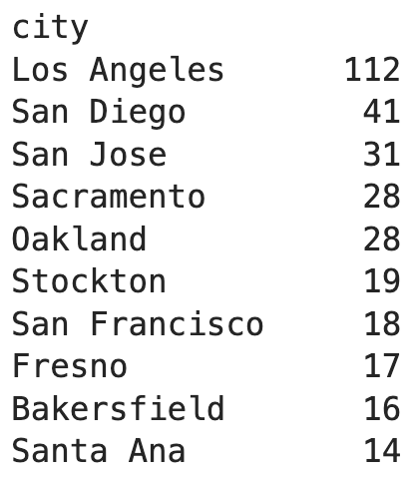
Connecting plots to real-world phenomena
There are three population hubs in California: Bay Area, LA/Orange County, and San Diego.
English | Polars code | SQL code
For each city, count the number of rows. | df['city'].value_counts() | SELECT COUNT(*) FROM admissions GROUP BY city

Slide 59
Back to application rates
Why is there so much variation in application rates across schools?
Lots of reasons. This is a hard issue.
Money, distance, academic resources, individual and family priorities, …
Starting point: How do application rates correlate with free reduced lunch (FRL) percentage?

Slide 60
Possible questions about the admissions dataset
Do you trust the data? How closely does it correspond to the truth? Context and inspection.
Which schools have the highest application/admission/attendance rates? Extremes.
How much do application/admission/attendance rates differ across schools? Distributions and variation.
How are distance from UC Berkeley, average socioeconomic status, free/reduced lunch percentage, and charter status related to the rates above? Correlation.
More on this one next time!

Slide 61
Exploratory Data Analysis (EDA) I
LECTURE 2
Data 100/Data 200, Fall 2026 @ UC Berkeley
Ramesh Sridharan and Jeremy Sanchez
Content credit: Acknowledgments

